Slide 1

Project NetProbe
x
Team Lead: Zaki Hasan Ali
SIP Developers: Christopher Lam, Fatima Khan, Aryaman Arora, Jisa Pius, Yassine Benjelloun

Slide 2



Meet the Team
Hi! I am Christopher Lam, worked as a Data Analyst Expert on the team
Hello! My name is Zaki Hasan Ali, and I am the project lead on the team
Fatima Khan here! I also worked as a Data Analyst Expert on the team

Slide 3



Meet the Team
Hi! I am Jisa Pius! I am a GUI Developer on the team
Hi! I am Yassine Benjelloun, worked as a Quality Testing Specialist
Hi! Aryaman Arora here, worked as a GUI Developer on the team as well

Slide 4
Figma Mockup - Our Initial Prototype

Slide 5
Overall Functionality

Slide 6
Consumer Importance
Technical aspects, why this helps the consumer and how this benefits them

Slide 7
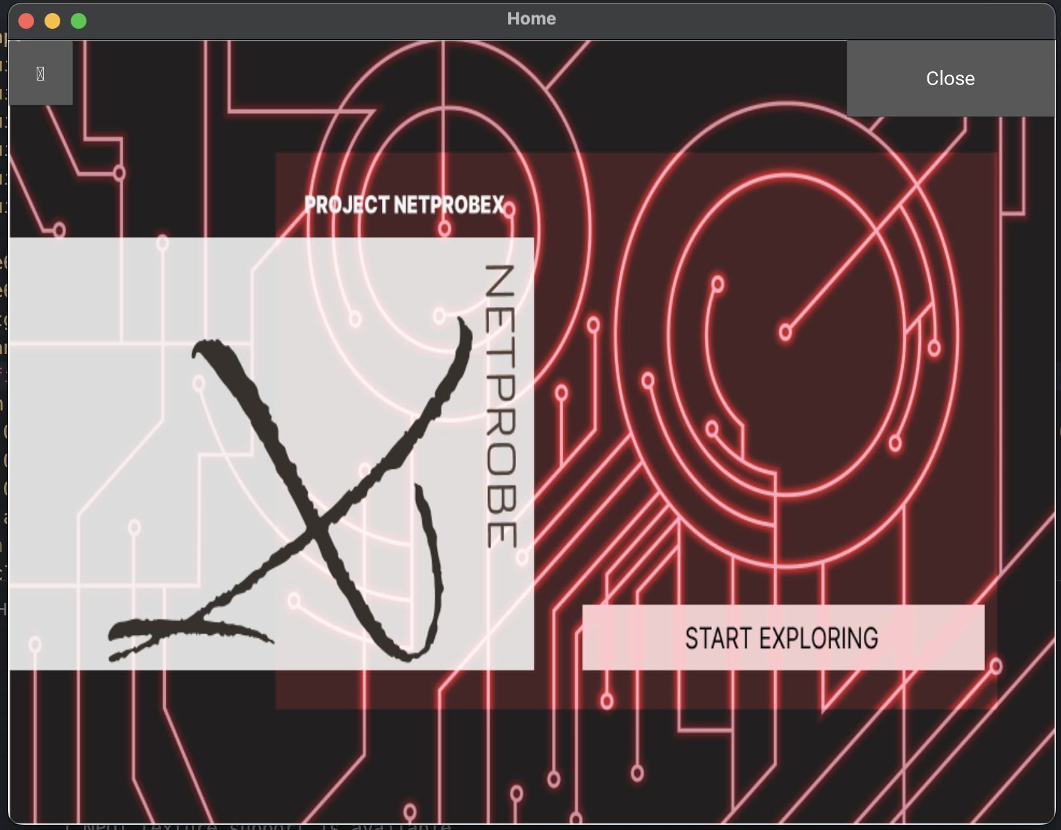
Home Page
Notes:
The image displayed, is our current home page for the application. On the top right corner, we have a button labeled close if the user decides that they are finished using the application. On the top left corner, we have the menu button, which opens and displays our main menu.

Slide 8
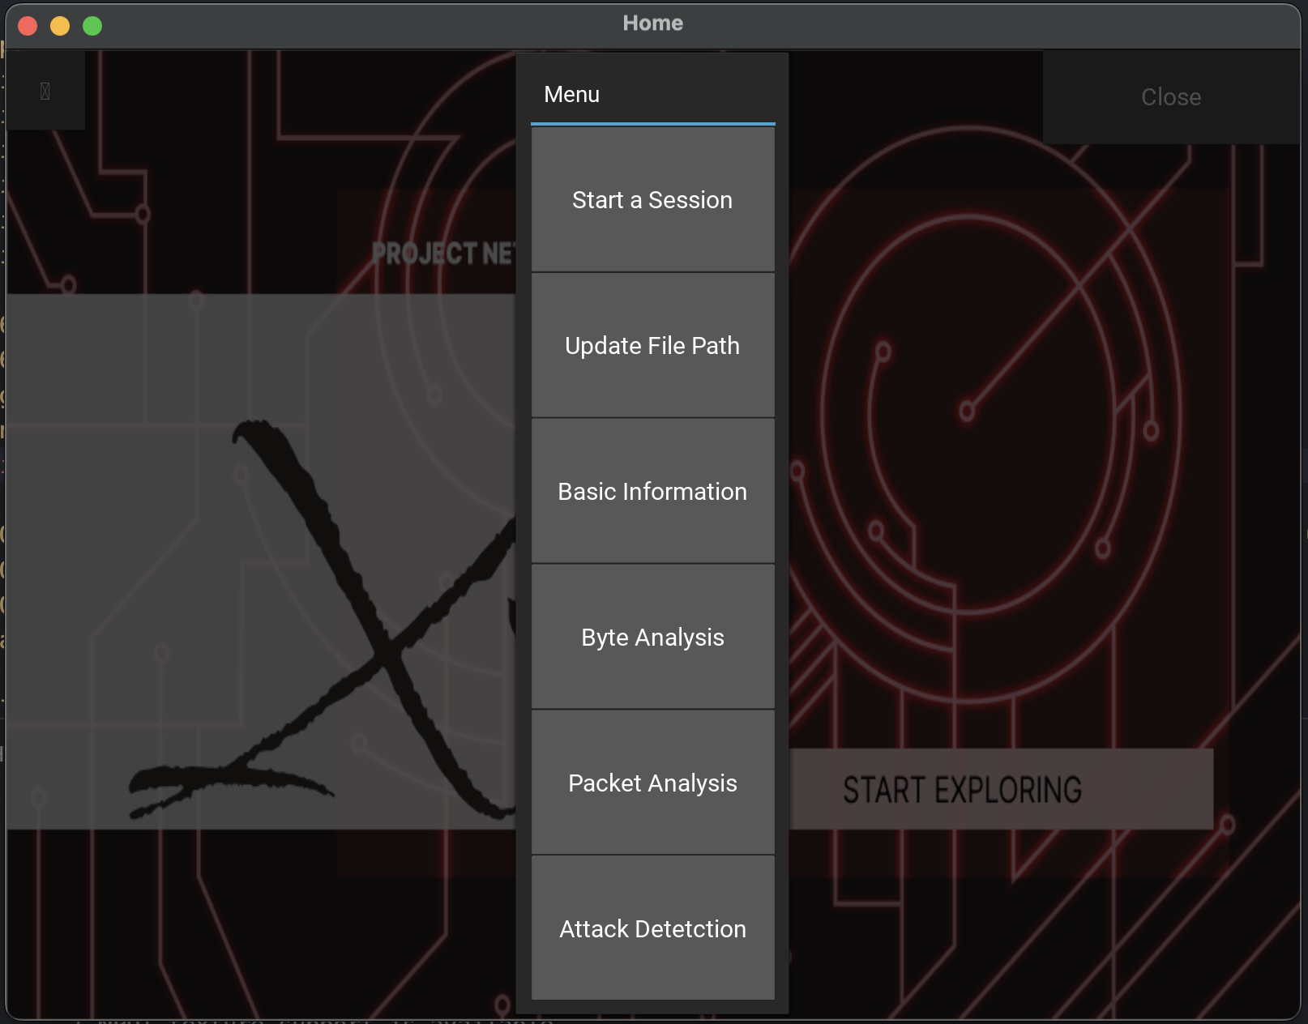
Main Menu
Notes:
The main menu allows the user to access all the different parts of the application. We currently have 6 different options such as Start a Session, Update File Path, Basic Information, Byte Analysis, Packet Analysis, and Attack Detection. In the next few slides, we will explain what information each part displays, and the benefit it can provide the user for having access to this information.

Slide 9
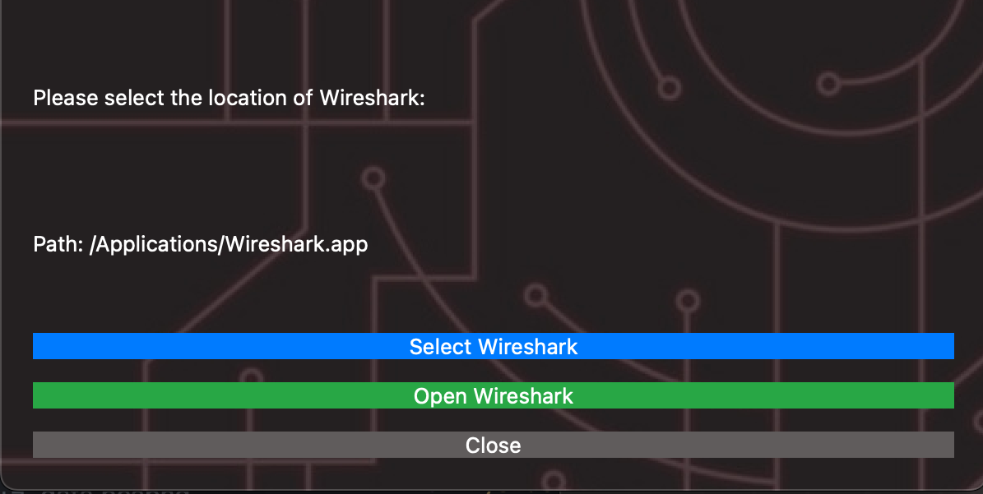
Main Menu
Notes:
The main menu allows the user to access all the different parts of the application. We currently have 6 different options such as Start a Session, Update File Path, Basic Information, Byte Analysis, Packet Analysis, and Attack Detection. In the next few slides, we will explain what information each part displays, and the benefit it can provide the user for having access to this information.

Slide 10
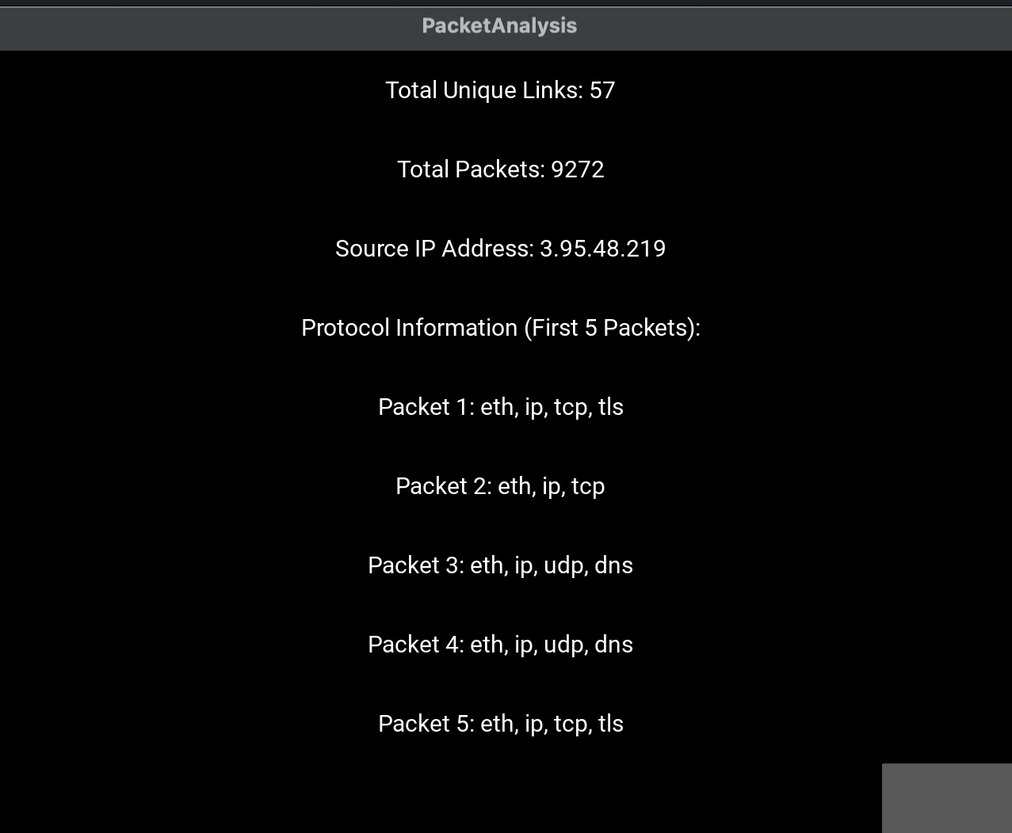
Basic Information
This page of the application shows the user basic real time information about their network

Slide 11
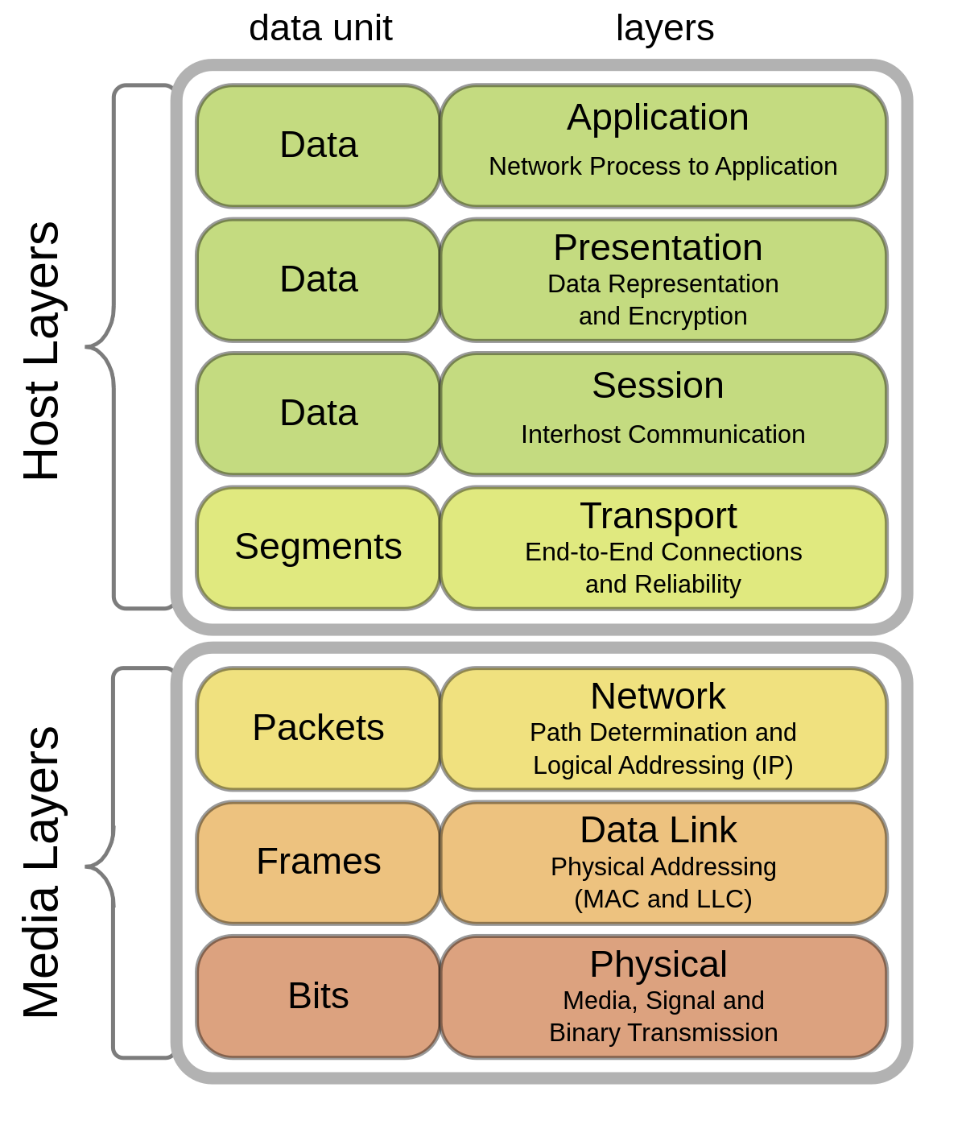
What Are Packets ?
Communication layers in the Open Systems Interconnection model
Fundamental data units transmitted over networks
Contain payload (actual data) and control information (source and destination, sequencing, error detection)
More efficient communication through data fragmentation, flexible routing, and reassembly at the destination
Notes:
*Control information is on the header
**Size of packets depends on payload, and header size is fixed and depends on the protocol

Slide 12
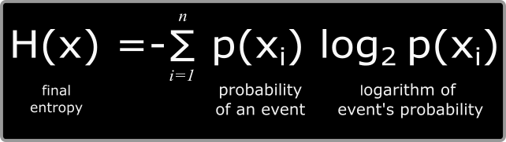
What Is Entropy ?
Measure of uncertainty or randomness within a system.
Quantifies the unpredictability of dataset values
Low entropy → less disorder
High entropy → more disorder
Methods of calculation vary based on context
In information theory, Shannon entropy is used
Formula for Shannon entropy
Notes:
* Entropy in the context of information theory and data analysis ** In simpler terms, entropy indicates how much "surprise" or disorder is present in a given set of data. A dataset with high entropy is more unpredictable and has more disorder, while a dataset with low entropy is more predictable and has less disorder.

Slide 13


Why We Care About Length Entropy Analysis
Enables anomaly-based detection of cyber attacks
DoS/DDoS attacks the target with high volume of similar packets, which would have low entropy
Encrypted traffic often exhibits irregularity in packet lengths due to the encryption process
Other possible detections: Covert channels, Protocol violations
False Positives:
Apps like video streaming or file transfers have high homogeneity in packet length
Some protocols require consistent payload length (VoIP, RTMP)

Slide 14
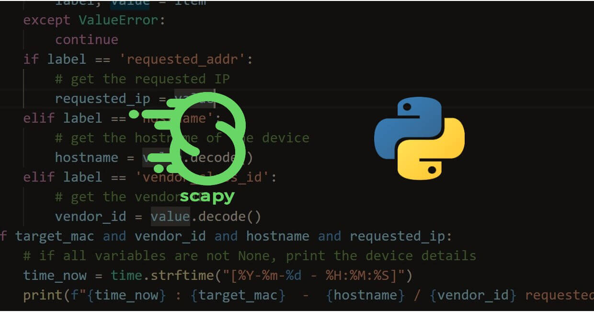
Cyber Attack Detection
Employing the Scapy Python library, renowned for its robust data capture capabilities
Scapy then was able to reassemble the packets
With the use of Shannon's formula the entropy was then calculated for each packet

Slide 15

Next Steps!
Develop additional features
Malware analysis
Network Encryption (VPN)
Develop a Web-based interface
To allow complete user functionality without locally downloading the software
Automating wireshark to perform automatically with a click of a button

